Slide 1
Transportation Problem

Slide 2
1 Formulating Transportation Problems
A transportation problem basically deals with the problem, which aims to find the best way to fulfill the demand of n demand points using the capacities of m supply points.
While trying to find the best way, generally a variable cost of shipping the product from one supply point to a demand point or a similar constraint should be taken into consideration.

Slide 3
Example 1: Powerco Formulation
Powerco has three electric power plants that supply the electric needs of four cities.
The associated supply of each plant and demand of each city is given in the table 1.
The cost of sending 1 million kwh of electricity from a plant to a city depends on the distance the electricity must travel.

Slide 4
Ex. 1 - continued
A transportation problem is specified by the supply, the demand, and the shipping costs. Relevant data can be summarized in a transportation tableau.
From | To
 | City 1 | City 2 | City 3 | City 4 | Supply (Million kwh)
Plant 1 | $8 | $6 | $10 | $9 | 35
Plant 2 | $9 | $12 | $13 | $7 | 50
Plant 3 | $14 | $9 | $16 | $5 | 40
Demand (Million kwh) | 45 | 20 | 30 | 30

Slide 5
Example 1: Solution
Decision Variables
  Powerco must determine how much power is sent from each plant to each city so x_{ij} = Amount of electricity produced at plant i and sent to city j
    x₁₄ = Amount of electricity produced at plant 1 and sent to city 4
Constraints
  A supply constraint ensures that the total quality produced does not exceed plant capacity. Each plant is a supply point.
  A demand constraint ensures that a location receives its demand. Each city is a demand point.
  Since a negative amount of electricity can not be shipped all x_{ij}’s must be non negative

Slide 6
Ex. 1 – Solution continued
LP Formulation of Powerco’s Problem
  Min Z = 8x₁₁+6x₁₂+10x₁₃+9x₁₄+9x₂₁+12x₂₂+13x₂₃+7x₂₄
  +14x₃₁+9x₃₂+16x₃₃+5x₃₄
  S.T.: x₁₁+x₁₂+x₁₃+x₁₄ <= 35 (Supply Constraints)
  x₂₁+x₂₂+x₂₃+x₂₄ <= 50
  x₃₁+x₃₂+x₃₃+x₃₄ <= 40
  x₁₁+x₂₁+x₃₁ >= 45 (Demand Constraints)
  x₁₂+x₂₂+x₃₂ >= 20
  x₁₃+x₂₃+x₃₃ >= 30
  x₁₄+x₂₄+x₃₄ >= 30
  x_{ij} >= 0 (i= 1,2,3; j= 1,2,3,4)

Slide 7
In general, a transportation problem is specified by the following information:
  A set of m supply points from which a good is shipped. Supply point i can supply at most s_{i} units.
  A set of n demand points to which the good is shipped. Demand point j must receive at least d_{i} units of the shipped good.
  Each unit produced at supply point i and shipped to demand point j incurs a variable cost of c_{ij}.

Slide 8
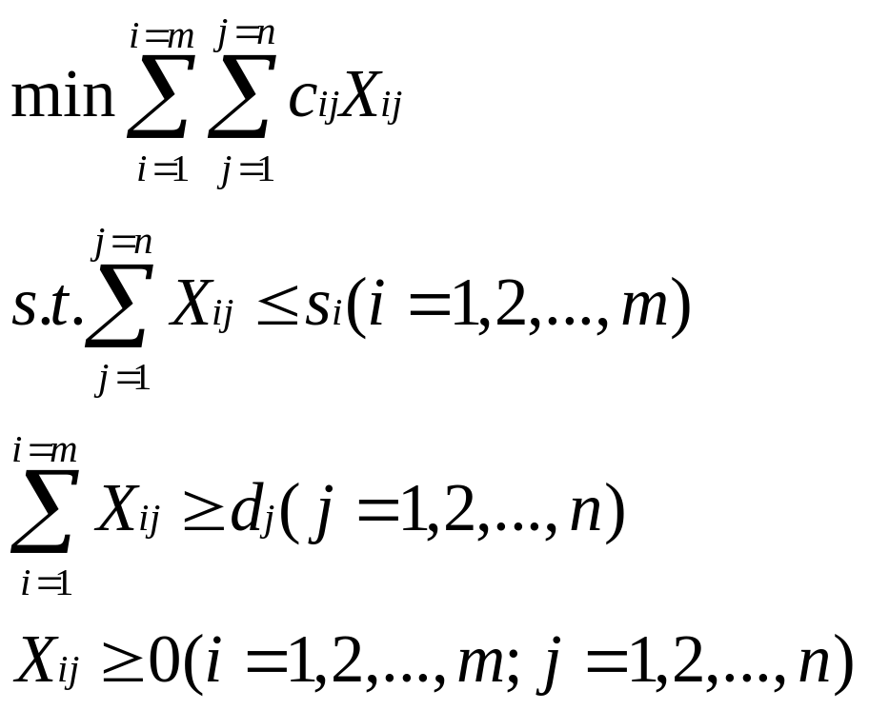
x_{ij} = number of units shipped from supply point i to demand point _{j}

Slide 9
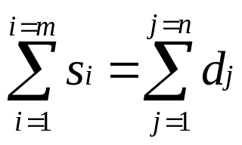
If
then total supply equals to total demand, the problem is said to be a balanced transportation problem.
If total supply exceeds total demand, we can balance the problem by adding dummy demand point. Since shipments to the dummy demand point are not real, they are assigned a cost of zero.

Slide 10
If a transportation problem has a total supply that is strictly less than total demand the problem has no feasible solution.
  No doubt that in such a case one or more of the demand will be left unmet.

Slide 11
2 Finding Basic Feasible Solution for Transportation Problems
Unlike other Linear Programming problems, a balanced transportation problem with m supply points and n demand points is easier to solve, although it has m + n equality constraints.
The reason for that is, if a set of decision variables (x_{ij}’s) satisfies all but one constraint, the values for x_{ij}’s will satisfy that remaining constraint automatically.

Slide 12
An ordered sequence of at least four different cells is called a loop if
  Any two consecutive cells lie in either the same row or same column
  No three consecutive cells lie in the same row or column
  The last cell in the sequence has a row or column with the first cell in the sequence
There are three basic methods to find the bfs for a balanced TP
  Northwest Corner Method
  Minimum Cost Method
  Vogel’s Method

Slide 13
To find the bfs by the Northwest Corner method:
  Begin in the upper left (northwest) corner of the transportation tableau and set x₁₁ as large as possible. X₁₁ can clearly be no larger than the smaller of s₁ and d₁.
  Continue applying this procedure to the most northwest cell in the tableau that does not lie in a crossed-out row or column.
  Assign the last cell a value equal to its row or column demand, and cross out both cells row and column.

Slide 14
The Northwest Corner Method does not utilize shipping costs. It can yield an initial bfs easily but the total shipping cost may be very high.
The minimum cost method uses shipping costs in order come up with a bfs that has a lower cost.
To find the bfs by the Minimum Cost method:
  Find the decision variable with the smallest shipping cost (x_{ij}). Then assign x_{ij} its largest possible value, which is the minimum of s_{i} and d_{j}

Slide 15
  Next, as in the Northwest Corner Method cross out row i and column j and reduce the supply or demand of the noncrossed-out row or column by the value of x_{ij}.
  Choose the cell with the minimum cost of shipping from the cells that do not lie in a crossed-out row or column and repeat the procedure.
Often the minimum cost method will yield a costly bfs.
Vogel’s method for finding a bfs usually avoids extremely high shipping costs.

Slide 16
To find the bfs by the Vogel’s method:
  Begin with computing each row and column a penalty. The penalty will be equal to the difference between the two smallest shipping costs in the row or column.
  Identify the row or column with the largest penalty.
  Find the first basic variable which has the smallest shipping cost in that row or column.
  Assign the highest possible value to that variable, and cross-out the row or column as in the previous methods.
  Compute new penalties and use the same procedure.

Slide 17
3 The Transportation Simplex Method
The Simplex algorithm simplifies when a transportation problem is solved.
By using the following procedure, the pivots for a transportation problem may be performed within the confines of the transportation tableau:
  Step 1 Determine the variable that should enter the basis.
  Step 2 Find the loop involving the entering variable and some of the basic variables.
  Step 3 Counting the cells in the loop, label them as even cells or odd cells.

Slide 18
  Step 4 Find the odd cells whose variable assumes the smallest value. Call this value θ. The variable corresponding to this odd cell will leave the basis.
  To perform the pivot, decrease the value of each odd cell by θ and increase the value of each even cell by θ. The variables that are not in the loop remain unchanged. The pivot is now complete.
    If θ=0, the entering variable will equal 0, and an odd variable that has a current value of 0 will leave the basis. In this case a degenerate bfs existed before and will result after the pivot.
    If more than one odd cell in the loop equals θ, you may arbitrarily choose one of these odd cells to leave the basis; again a degenerate bfs will result

Slide 19
Two important points to keep in mind in the pivoting procedure
  Since each row has as many +20s as –20s, the new solution will satisfy each supply and demand constraint.
  By choosing the smallest odd variable (x₂₃) to leave the basis, we ensured that all variables will remain nonnegative.

